Slide 1
TCP Congestion Control

Slide 2
Goal of TCP Congestion Control
Goal of TCP is to determine the available network capacity and prevent network overload.
  Depends on other connections that share the resources.
Typically, in discussions, First in First Out queues are assumed; however, congestion control mechanisms work with other queuing techniques (fair queuing) as well.

Slide 3
Why prevent congestion ?
Congestion is bad for the overall performance in the network.
  Excessive delays can be caused.
  Retransmissions may result due to dropped packets
    Waste of capacity and resources.
  In some cases (UDP) packet losses are not recovered from.
  Note: Main reason for lost packets in the Internet is due to congestion -- errors are rare.

Slide 4
The Congestion Window
In order to deal with congestion, a new state variable called “CongestionWindow” is maintained by the source.
  Limits the amount of data that it has in transit at a given time.
MaxWindow = Min(Advertised Window, CongestionWindow)
EffectiveWindow = MaxWindow - (LastByteSent -LastByteAcked).
TCP sends no faster than what the slowest component -- the network or the destination host --can accommodate.

Slide 5
Managing the Congestion Window
Decrease window when TCP perceives high congestion.
Increase window when TCP knows that there is not much congestion.
How ? Since increased congestion is more catastrophic, reduce it more aggressively.
Increase is additive, decrease is multiplicative -- called the Additive Increase/Multiplicative Decrease (AIMD) behavior of TCP.

Slide 6
AIMD details
Each time congestion occurs - the congestion window is halved.
  Example, if current window is 16 segments and a time-out occurs (implies packet loss), reduce the window to 8.
  Finally window may be reduced to 1 segment.
Window is not allowed to fall below 1 segment (MSS).
For each congestion window worth of packets that has been sent out successfully (an ACK is received), increase the congestion window by the size of a (one) segment.
Source
Destination

Slide 7
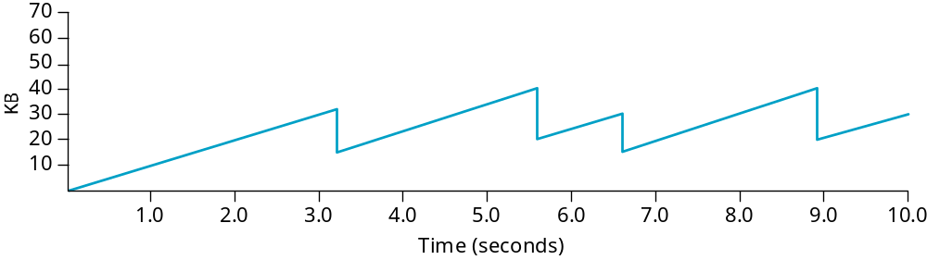
More AIMD details
Remember that TCP is byte oriented.
  does not wait for an entire window worth of ACKs to add one segment worth to congestion window.
Reality: TCP source increments congestion window by a little for each ACK that arrives.
  Increment = MSS * (MSS/Congestion Window)
    This is for each segment of MSS acked.
  Congestion Window + = Increment.
Thus, TCP demonstrates a sawtooth behavior !

Slide 8
TCP Slow Start
Additive Increase is good when source is operating at near close to the capacity of the network.
  Too long to ramp up when it starts from scratch.
  Slow start --> increase congestion window rapidly at cold start.
Slow start allows for exponential growth in the beginning.
    E.g. Initially CW =1, if ACK received, CW = 2.
    If 2 ACKs are now received, CW = 4. If 4 ACKs are now received, CW =8 and so on.
Note that upon experiencing packet loss, multiplicative decrease takes over.
Source
Destination

Slide 9
Why Call it Slow Start ?
The original version of TCP suggested that the sender transmit as much as the Advertised Window permitted.
Routers may not be able to cope with this “burst” of transmissions.
Slow start is slower than the above version -- ensures that a transmission burst does not happen at once.

Slide 10
A second scenario
Let us say TCP has sent Advertised Window worth of packets.
No ACKs are received and TCP times-out and continues to block the application.
Ultimately an ACK is received which specifies that all sent packets are received (remember ACKs are cumulative).
Now, instead of dumping Advertised Window worth of packets (again a burst), TCP resorts to Slow start.

Slide 11
Where does AIMD come in now ?
Slow start is used to increase the rate to a “target window size” prior to AIMD taking over.
What is this target window size ? -- Unclear
In addition, we now have to do book keeping for two windows -- the congestion window and the “target congestion window” where Slow start ends and AIMD begins.

Slide 12
The Congestion Threshold
Initially no target window -- when a packet loss occurs, divide the current CW by 2 (due to multiplicative decrease) -- this now becomes the target window.
Define this to be the “Congestion Threshold”.
Reduce actual CW to 1.
Use Slow Start to ramp up to the Congestion Threshold (or simply threshold). Once this is reached use AIMD.

Slide 13
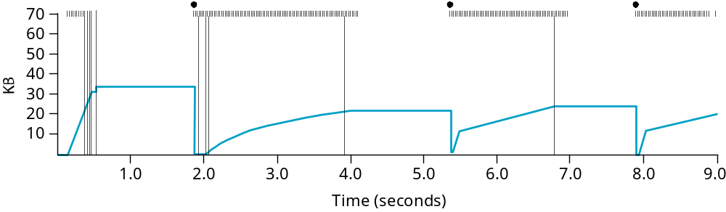
Summary: TCP Tahoe
Thus:
  When CW is below the threshold, CW grows exponentially
  When it is above the threshold, CW grows linearly.
  Upon time-out, set “new” threshold to half of current CW and the CW is reset to 1.
  This version of TCP is called “TCP Tahoe”.

Slide 14
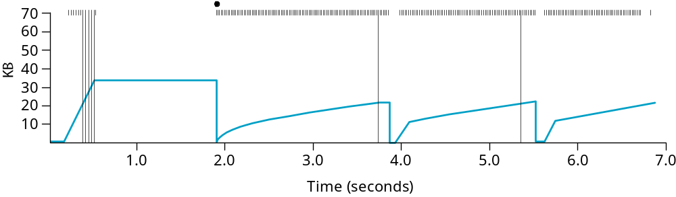
Fast Retransmit
Coarse grained TCP time-outs sometimes lead to long periods wherein a connection goes dead waiting for a timer to expire.
Fast Retransmit -- a heuristic that sometimes “triggers” the retransmission of a packet faster than permissible by the regular time-out.
Every time a data packet arrives at a receiver, the receiver ACKs even though the particular sequence number has been ACKed.
Thus, when a packet is received in out of order, resend the ACK sent last time -- a duplicate ACK!

Slide 15
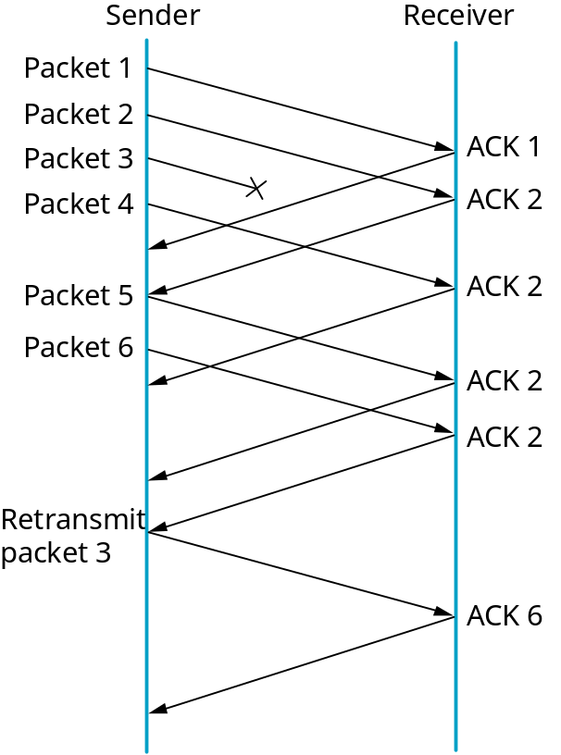
Duplicate ACKs
When a duplicate ACK is seen by the sender, it infers that the other side must have received a packet out of order.
  Delays on different paths could be different -- thus, the missing packets may be delivered.
  So wait for “some” number of duplicate ACKs before resending data.
  This number is usually 3.

Slide 16
Fast Recovery
When the fast retransmit mechanism signals congestion, the sender, instead of returning to Slow Start uses a pure AIMD.
  Simply reduces the congestion window by half and resumes additive increase.
Thus, recovery is faster -- this is called Fast Recovery.

Slide 17
TCP Reno
The version of TCP wherein fast retransmit and fast recovery are added in addition to previous congestion control mechanisms is called TCP Reno.
  Has other features -- header compression (if ACKs are being received regularly,omit some fields of TCP header).
  Delayed ACKs -- ACK only every other segment.

Slide 18
Why Congestion Avoidance?
TCP increases load to determine when congestion occurs and then backs off.
Losses are the events that determine congestion.
But costly -- can we predict the onset of congestion ? Prevent loss ?

Slide 19
DECbit
Split the responsibility of congestion control between end hosts and routers.
Router monitors congestion and explicitly notifies end-host when congestion is about to occur
  Set a binary congestion bit called DECbit.
The notification reaches the destination which copies the bit in the ACK that it sends the source.
In response, the source adjusts transmit rate.

Slide 20
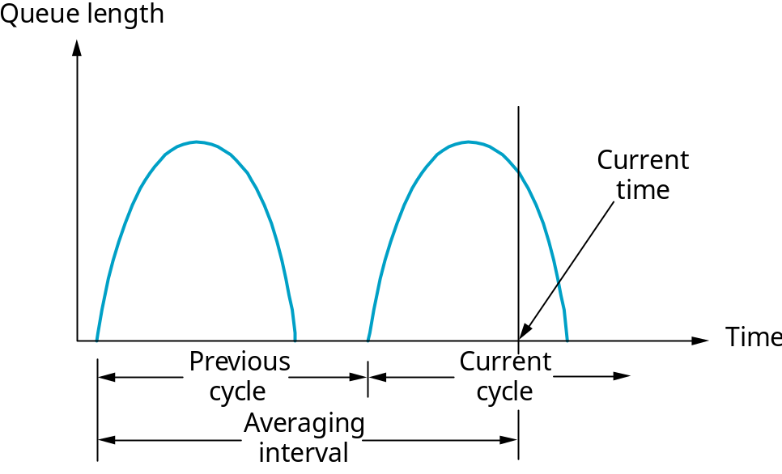
When is congestion perceived ?
The criterion for congestion is that the average queue length must be greater than or equal to 1.
This average is computed over a time-interval that spans the previous busy + idle + current busy periods.

Slide 21
The source response
The source watches as to what fraction of the received messages have the DECbit set.
If this number > 50 % then, congestion window = 0.875 the previous window.
Else, if it is < 50 %, congestion window + = 1.

Slide 22
Random Early Drop (RED)
Very similar to DECbit.
Each router monitors its queue length and if the queue length is longer than a certain value, drop packets (implicit notification) to indicate congestion.
  DECbit is an explicit form of notification.
Note that packets are dropped much earlier than usual -- before buffer resources are exhausted completely -- so drops are fewer
  Bursty drops are also reduced.

Slide 23
Details of RED
The principle is to drop the packet with some “drop probability” when the queue length exceeds a certain “drop level”.
Instead of a sample queue length, average queue length (more accurately captures notion of congestion) is considered.
AvgLen = (1-weight)*AvgLen + weight * SampleLen

Slide 24
More RED Details
With RED, two thresholds are maintained -- the MinThreshold and MaxThreshold.
If AvgLen <= MinThreshold queue packet
If AvgLen >= MaxThreshold drop arriving packet.
If MinThreshold <= AvgLen <= MaxThreshold, then, calculate a drop probabilty P (as we will see) and drop the arriving packet with the probability P.

Slide 25
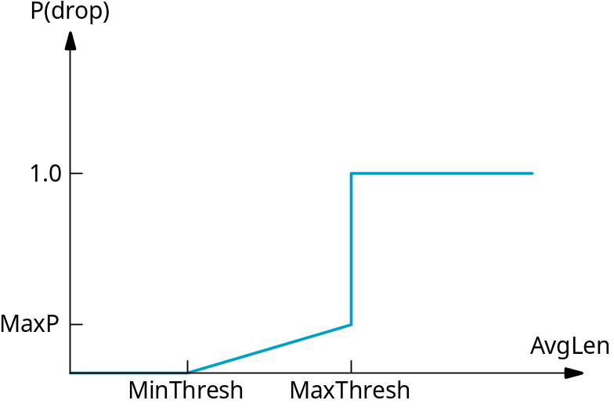
The Drop probability
We define a new quantity called MaxP
This is the maximum value that P can take.
Linear increase between MinThresh and MaxThresh.
In reality it is more complex -- depends on how long has it been from last drop.
We define:
TempP = {MaxP * (AvgLen-MinThresh)} /(MaxThresh-MinThresh)
and then, P = Temp/(1-count X TempP)
Here, count keeps track of the number of “newly” arriving packets that have been queued.

Slide 26
More about the drop probability
With an increase in count, notice that P increases.
This means that if a lot of new packets have been received after a drop, it is time to drop again!
Thus, this leads to “widely spaced” drops (a larger packet accumulation before consecutive drops) rather than closely spaced drops.
If sources are sending more data, more likely that their packets get dropped.
Rest of RED -- self-study.

Slide 27
A Visit to Vegas
Having routers participate in congestion control requires changes to core routers -difficult.
It is better to do this end-to-end.
However, we want to still have source based control -- now, it would be source-based congestion avoidance.
We need a TCP that watches out for signs of congestion --TCP Vegas.

Slide 28
Noting RTT variations
How much does the RTT increase with each packet sent ?
  Note that with each additional packet, we are adding load.
One way -- compute for every two round trip delays (with an increase in a segment) to see if observed RTT > avg of min and maximum RTT.
If yes, reduce congestion window.

Slide 29
A second possibility
Every RTT increase congestion window by a packet (or segment).
Compute throughput as number of outstanding bytes divided by RTT.
Also keep the value of the throughput that was achieved when only one packet was in transit (at the beginning of the connection).
If the difference between current throughput and this above tagged throughput is less than 1/2 decrease congestion window by 1.

Slide 30
TCP Vegas
Somewhat in line with what we saw in the previous examples.
Source tries to match the available bandwidth exactly.
TCP source maintains what is known as BaseRTT -- the RTT when the flow is not congested -- typically the minimum of all RTTs observed.
It uses this value to determine if or not congestion is being experienced.

Slide 31
Expected and Actual Rates
The source computes an Expected Rate -- Expected Rate = CongestionWindow/BaseRTT
Actual Rate is also computed -- number of bytes transmitted during the RTT of a tagged packet.
Diff = Expected Rate - Actual Rate.
Note that the Diff is always greater than or equal to zero (BaseRTT is the lowest !).

Slide 32
Vegas Rules
Define two thresholds α and β.
If Diff < α, TCP vegas increases congestion window linearly during next RTT.
If Diff > β, it decreases the congestion window linearly.
If α < Diff < β, TCP vegas leaves the congestion window as is.

Slide 33
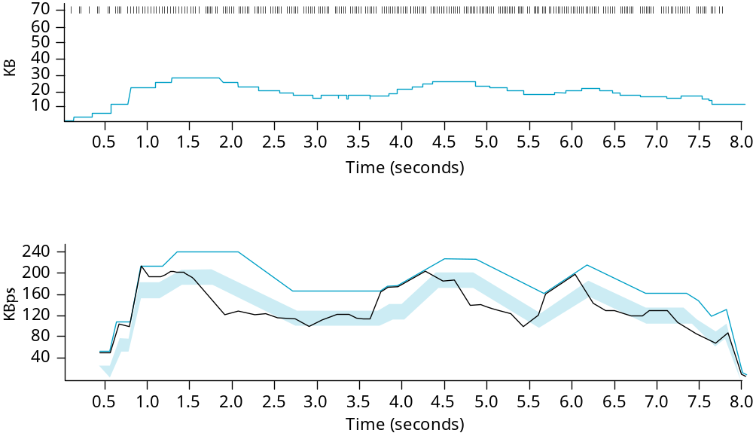
Vegas Behavior
Green Line -- Expected throughput
Black Line -- Actual throughput
Shaded area -- region between α and β thresholds

